Slide 1


FINAL PROJECT CS 661

Slide 2
CAR PRICE PREDICTION

Slide 3
Presented By: Tejaswini Kandyala
Manognya Raygir
Nikhil Katakam
Drona Gangarapu

Slide 4

AGENDA
Introduction
Dataset Description
Exploratory Data Analysis (EDA)
Machine Learning Model Development
Machine Learning Model Evaluation
Conclusion

Slide 5
INTRODUCTION

Slide 6
INTRODUCTION
This presentation is about car selection based on the prices.
A dataset is collected keeping various parameters in mind that can help the customers select a suitable car from various brands and features that are easy on their pocket (i.e., affordable to the customers).
This dataset intends to help the customer find a car.
In general, other different parameters considered while selecting to buy a car are car model, year of production, brand, features, mileage, fuel type, etc.

Slide 7
INTRODUCTION
PROBLEM
It is impossible for the customers to be aware of all the details of cars, such as the prices.
So, while selecting a car to purchase they are perplexed.
As the car selection is done keeping many factors in mind and one of the main factors is the “Price” of the car.
It is difficult to determine a car’s price and select the best features of the car.

Slide 8
INTRODUCTION
AIM
To help the customer purchase the cars based on their financial capability.
OBJECTIVE
To predict the car prices.

Slide 9
DATASET DESCRIPTION

Slide 10
DATASET DESCRIPTION
“Car price dataset” is selected from the Kaggle website (Mohanty, 2021).
The URL of this dataset is: https://www.kaggle.com/datasets/sidharth178/car-prices-dataset
The variables of this dataset are:
ID, Levy, Price: price of the car (Target Column), Manufacturer, Model, Prod. Year, Category, Leather interior, Fuel type, Engine volume, Mileage, Cylinders, Gear, ox type, Drive wheels, Doors, Colour, Wheel, and Airbags

Slide 11
EXPLORATORY DATA ANALYSIS

Slide 12
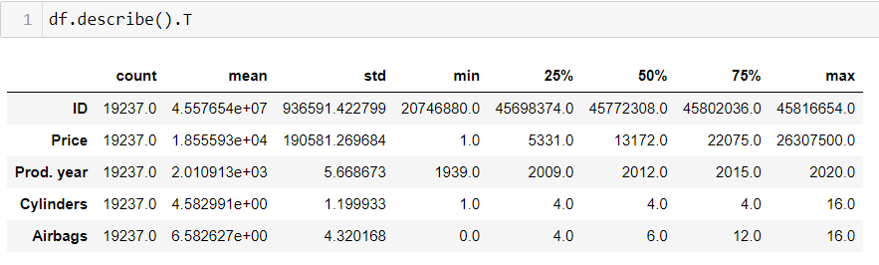
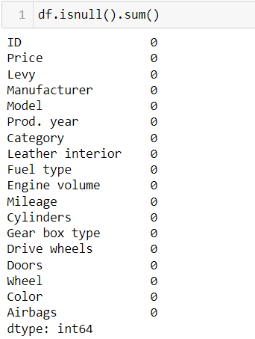
EXPLORATORY DATA ANALYSIS
STEP 1: Dataset importing.
STEP 2: Check the missing values. And, no missing values were in this dataset.
STEP 3: Conduct statistical analysis with describe function.

Slide 13
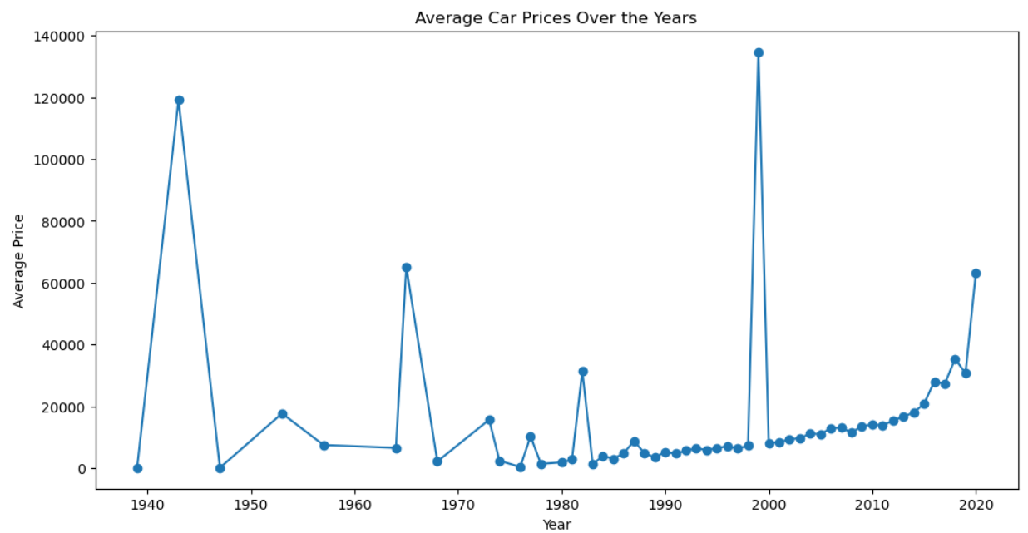
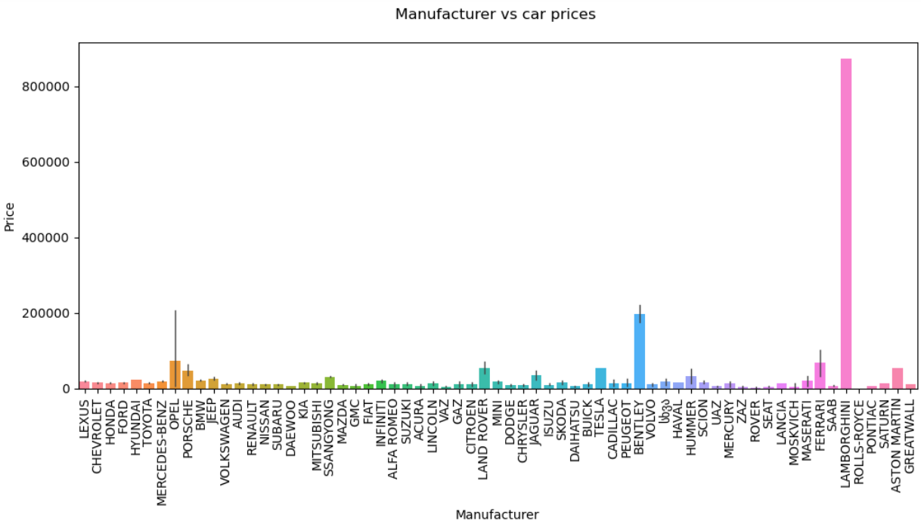
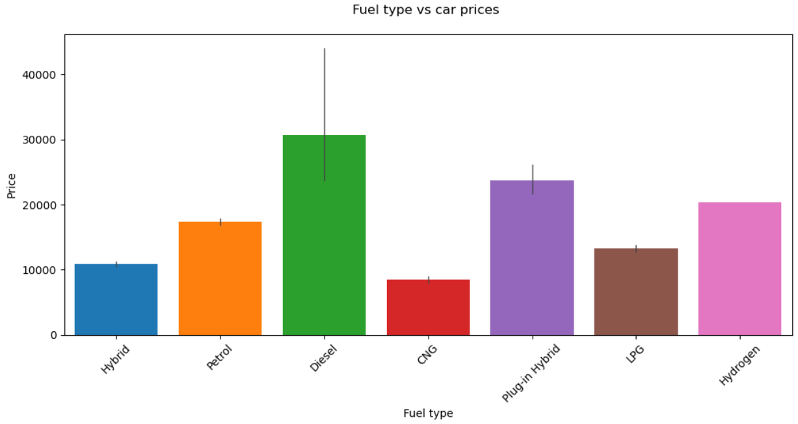
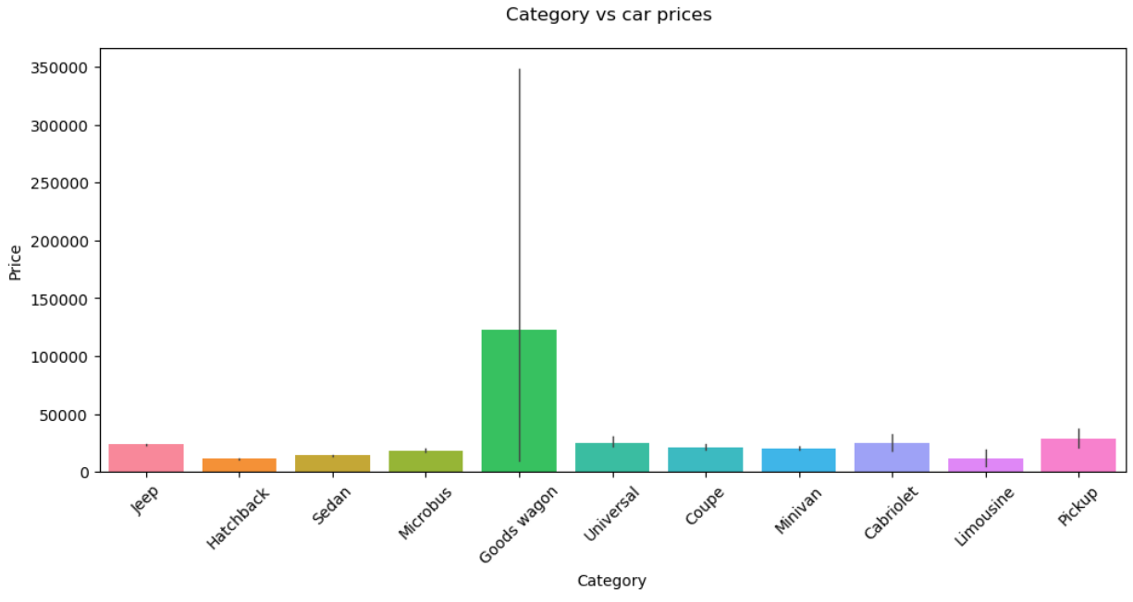
EXPLORATORY DATA ANALYSIS
Car price based visualizations.

Slide 14
EXPLORATORY DATA ANALYSIS
STEP 4: Car prices over the years is visualized.
Notes:
As per the above visualization,
The year 2000 had the highest car prices compared to other years.
In contrast to other years, 1970 had the lowest car prices.

Slide 15
EXPLORATORY DATA ANALYSIS
STEP 5: Based on the manufacturer, the car price is visualized.
Notes:
As per the visualization, Lamborghini manufacturer is shown to have the highest car price, whereas ROVER, ZAZ, and SEAT manufacturers are shown to have the lowest car prices compared to the other manufacturers.

Slide 16
EXPLORATORY DATA ANALYSIS
STEP 6: Car price is visualized based on fuel type.
Notes:
As per the visualization, Diesel fuel type is observed to have the highest car price. But, CNG and hybrid fuel type are the lowest car prices than the other fuel types.

Slide 17
EXPLORATORY DATA ANALYSIS
STEP 7: With car category visualize the car prices.
Notes:
As per the visualization, Goods wagon category showed to have the highest car price, whereas the lowest ones are Hatchback, Limousine and Microbus.

Slide 18
EXPLORATORY DATA ANALYSIS
STEP 8: Conduct feature selection and split the dataset into a train set and test set.
STEP 9: At the end, encode categorical variables for building machine learning models and predict the car prices.
Notes:
Before proceeding, cut the price variable into two categories such as below 30K and above 30K to help the user predict the prices based on the two categories like the cars above and below 30K. Then, set the target variable as “Price” and other variables are considered as response variables. Next, split the dataset into train and test set.

Slide 19
MACHINE LEARNING MODEL DEVELOPMENT

Slide 20




MACHINE LEARNING MODEL DEVELOPMENT
Logistic Regression
Decision Tree
Result
Predicted Car Price
Result
Predicted Car Price

Slide 21

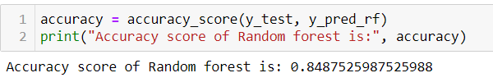
MACHINE LEARNING MODEL DEVELOPMENT
Random Forest
Result
Predicted Car Price

Slide 22
MACHINE LEARNING MODEL EVALUATION

Slide 23
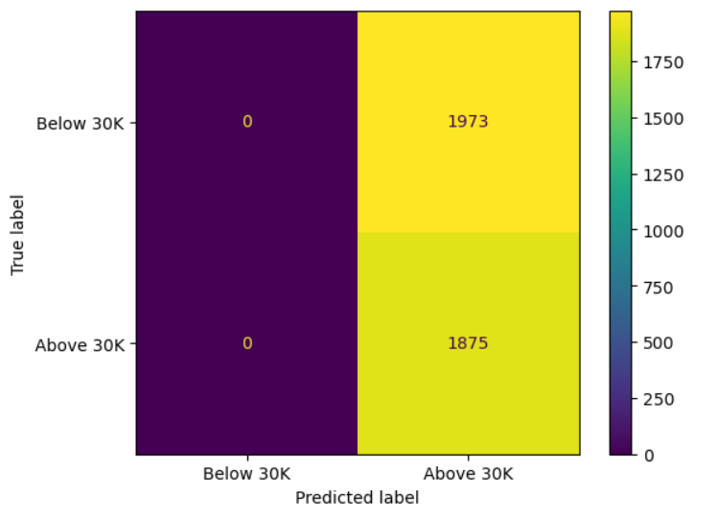
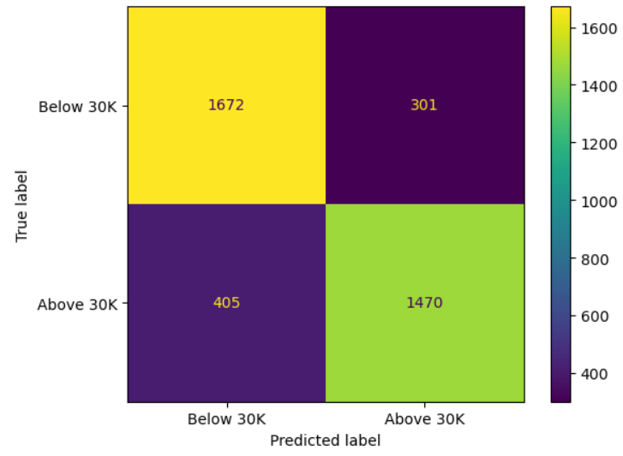
MACHINE LEARNING MODEL EVALUATION
Logistic Regression
Decision Tree
Accuracy: 48.72%
Accuracy: 81.65%
Notes:
For logistic regression, the determined accuracy is 48.72%.
For the decision tree classifier model, the determined accuracy is 81.65%.

Slide 24
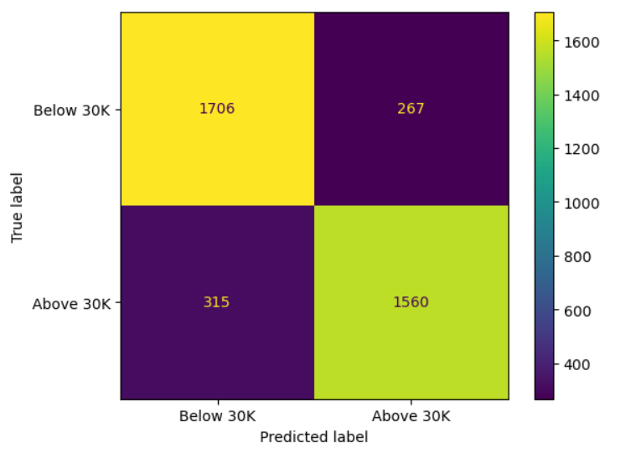
MACHINE LEARNING MODEL EVALUATION
Random Forest
Accuracy: 84.87%
Notes:
For the random forest classifier model, the determined accuracy is 84.87%.
For MLP model, the determined accuracy is 48.72%, and it is less for this prediction.

Slide 25
CONCLUSION

Slide 26
CONCLUSION
The car price dataset is analyzed with the help of machine learning models and Python programming.
It is concluded that the random forest model is the best model to predict car prices.
This result is concluded based on the accuracy of the models.
Among the 3 models, random forest had the highest accuracy.

Slide 27
REFERENCES

Slide 28
REFERENCES
Kiran, V.S. et al. (2022) ‘USED CAR PRICE PREDICTION’, Journal of Engineering Sciences, 13(06), pp. 387–398.
Maddali, S. (2022) Predicting car prices using machine learning and Data Science, Medium. Available at: https://medium.com/odscjournal/predicting-car-prices-using-machine-learning-and-data-science-52ed44abab1b (Accessed: 08 February 2024).
Mohanty, S.K. (2021) Car prices dataset, Kaggle. Available at: https://www.kaggle.com/datasets/sidharth178/car-prices-dataset (Accessed: 08 February 2024).
Singh, A. (2023) How: Implementing decision trees in python with Scikit-Learn (part 3), Medium. Available at: https://medium.com/@diehardankush/how-implementing-decision-trees-in-python-with-scikit-learn-part-3-29e5a787baaf (Accessed: 08 February 2024).
Vermani, G. (2022) How to perform logistic regression in sklearn -, ProjectPro. Available at: https://www.projectpro.io/recipes/perform-logistic-regression-sklearn (Accessed: 08 February 2024).

Slide 29
Any Questions?

Slide 30
Thank You

